Slide 1
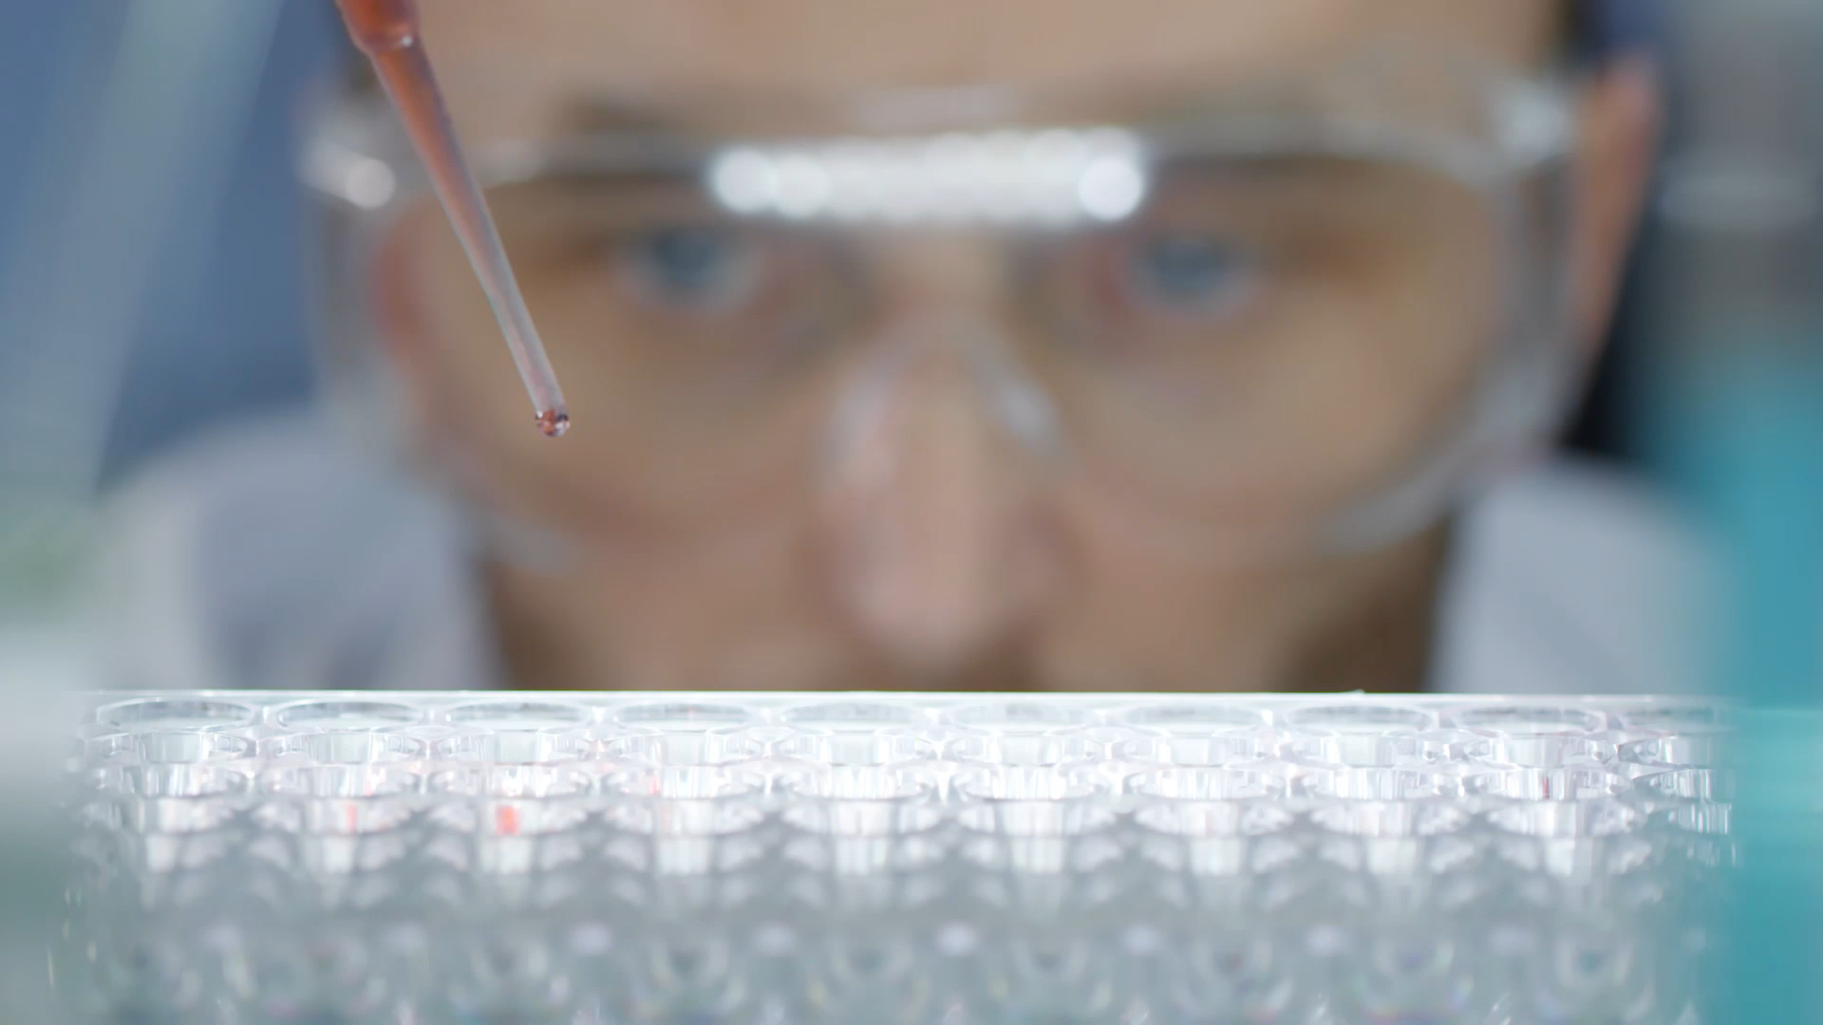
Analyzing a SIR Model: How effective do masks need to be to cut the peak number of infected persons by 50%?
Michaela Fox & Ashley Yang

Slide 2
What is our Question?
We are trying to figure out how effective masks need to be to cut the peak number of infected people by 50%.
We are trying to predict the peak number of future infected persons based on mask effectiveness.
Uses of this research: companies can work towards manufacturing masks that will create a noticeable difference in the number of people getting sick

Slide 3
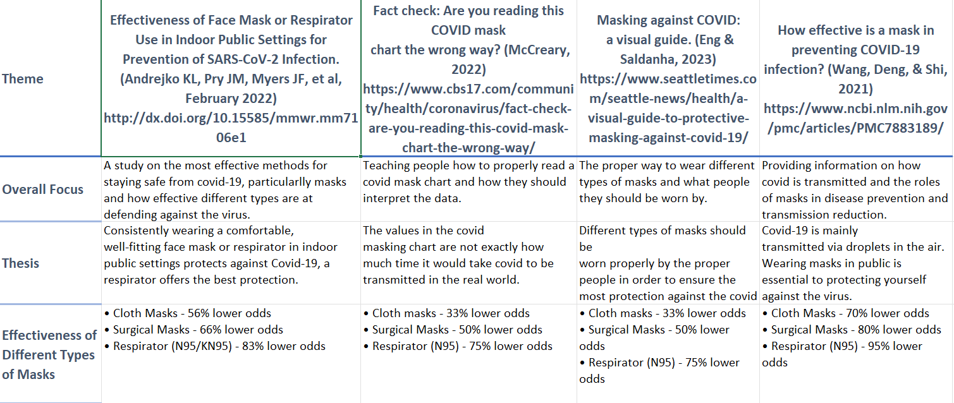
Research:

Slide 4
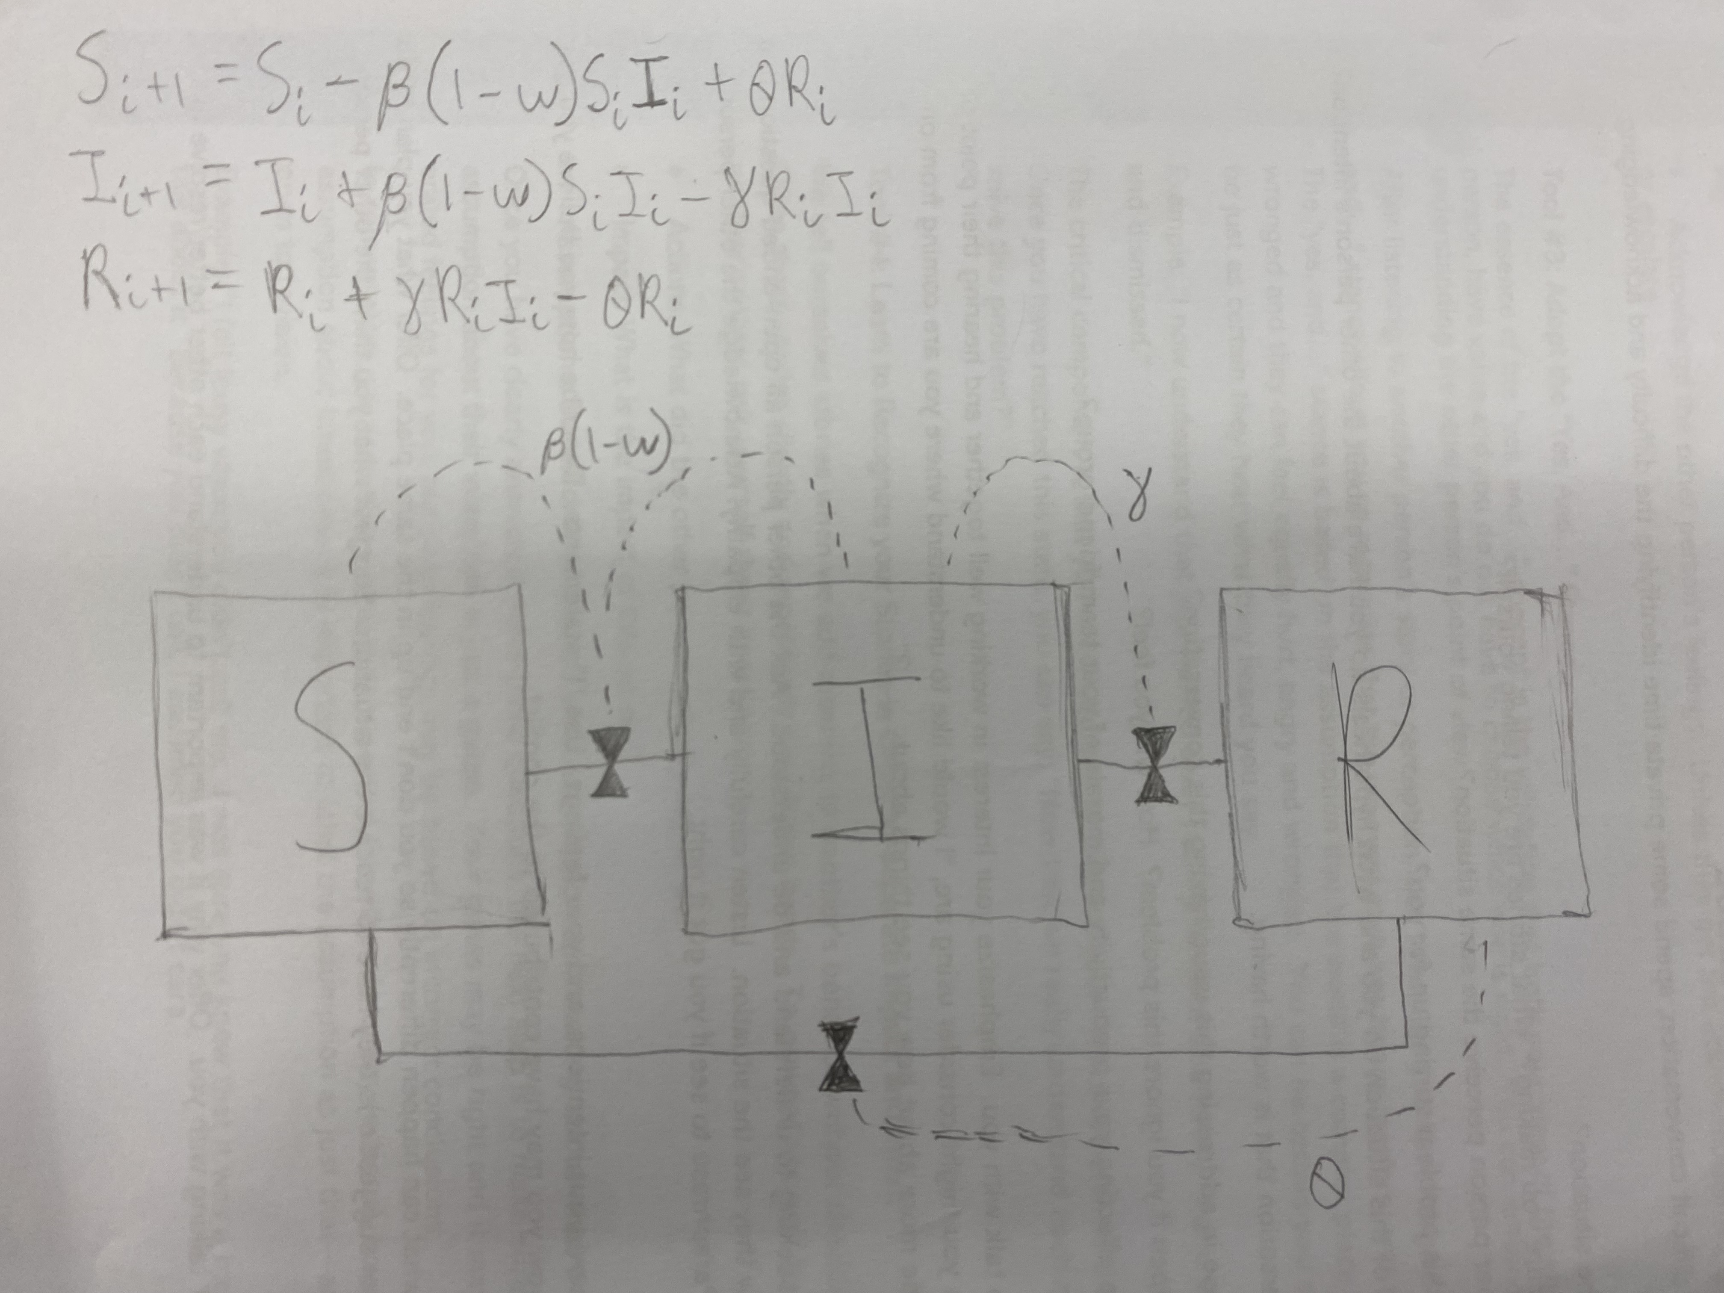
Model:
Stocks:
S stock - # of susceptible people
I stock - # of infected people
R stock - # of recovered people
Flows:
β(1-ω) – the infection rate
γ – the recovery rate
θ – the reinfectivity rate
Assumed that everyone is wearing the same type of mask
Assumed everyone eventually recovers (as opposed to dying)

Slide 5
Model:
Our unique parameter:
ω – effectivity percentage of masks
Used for infection rate β(1-ω)
Verification facts:
Total number of people stays at 100 throughout the model
The number of people in each stock doesn’t go below 0

Slide 6
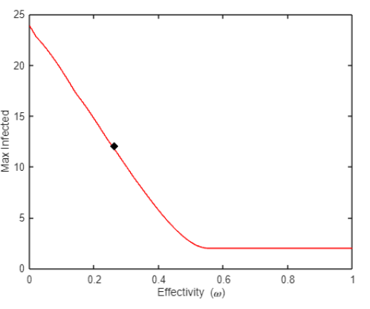
Results: Parameter Sweep
Metric: the peak number of infected persons
Masks need to be at least 26% effective to decrease the max number of infected individuals by 50%
Important Trends:
linear decrease in the max number of infected people as effectivity of masks increases from 0 to 0.5
If effectivity is greater than about 0.5 then there is no change to the max number of infected people

Slide 7
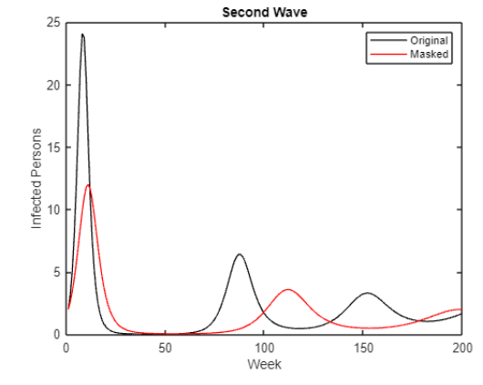
Results: Simulated Disease

Slide 8
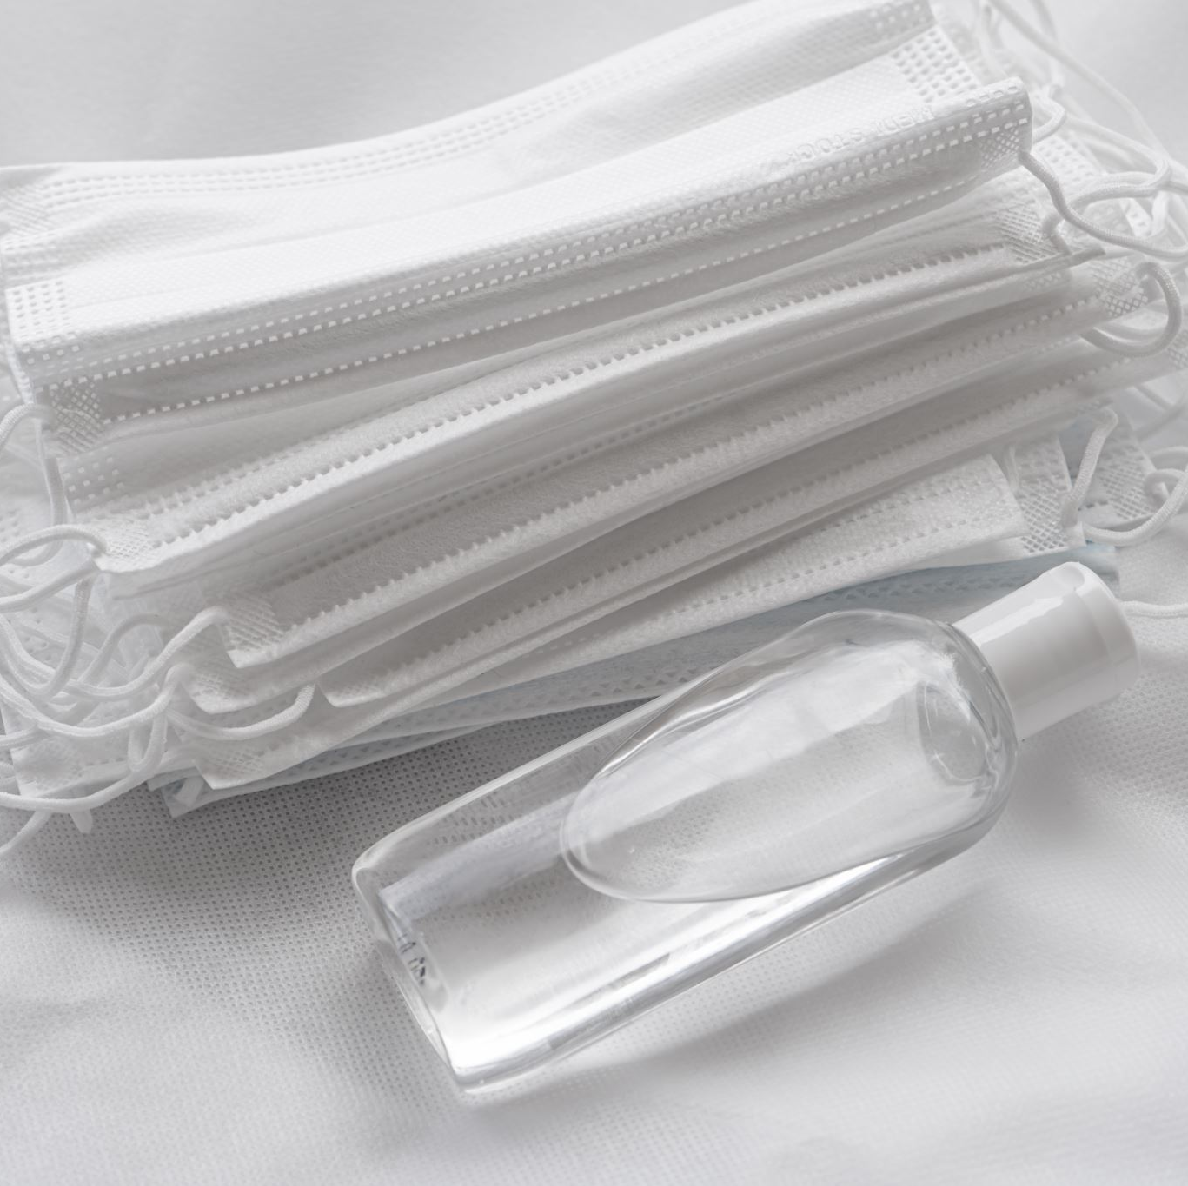

What do our results mean?
Conclusion: masks need to be 26% effective to cut the peak number of infected individuals by 50%
Limitations: cannot predict how many people are wearing masks or what kind of masks they are wearing
Possible future improvements:
Implement different types of masks to see which ones offer the best protection and can further decrease the max number of infected, possibly by 75%
See how many people need to be wearing masks to cut the max number of infected by 50%

